Slide 1
MY Solution
Martin Molnár

Slide 2
Contents of the presentation
Philosophy
Data Visualization
Development Roadmap
My Code
Questions

Slide 3
Philosophy
Less Data
Homogenous data
Fast prototype

Slide 4

Data visualization – Image approach

Slide 5
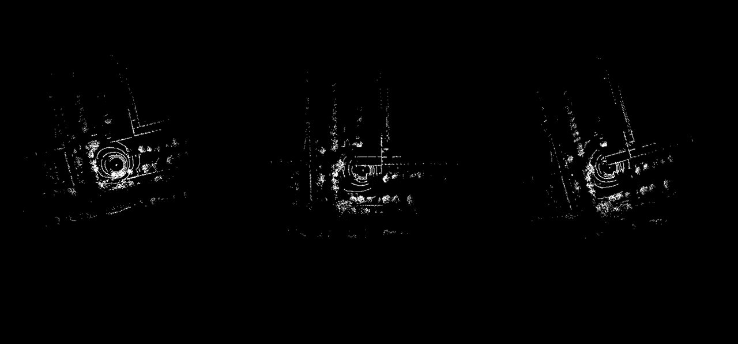
Data visualization – pointcloud approach

Slide 6
Development roadmap i.
Image generation (C#)
Training (Python TensorFlow)
Prediction (Python TensorFlow)
SSD failure

Slide 7
Development roadmap ii.
Image generation (Python)
optimalisation
Training (Python TensorFlow)
Prediction (Python TensorFlow)

Slide 8
Development roadmap iiI.
Output in a CVS file
Integration in a single file

Slide 9
My Code
Image Generation
Fit the XYZ data into a suitable shape
Generate a binary bitmap
Export the bitmap into a 224 x 224 PNG
Model Training
Create TensorFlow layers with image classification in mind
Train the model with 80/20 split
Retrain the model with warped images
Display the training data with matplotlib/tensorboard
Prediction
Load random images and see how accurate the model is on untrained data

Slide 10


Questions

